Slide 1
Using neural networks to decode EEG and read your thoughts
Building a yes/no classifier to help people with central nervous system injuries communicate

Slide 2
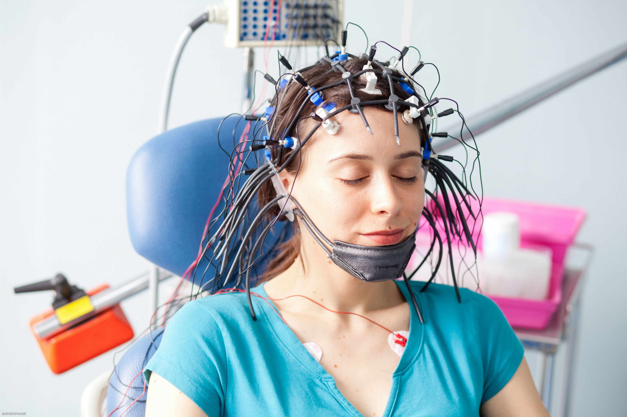
What is an EEG machine?

Slide 3
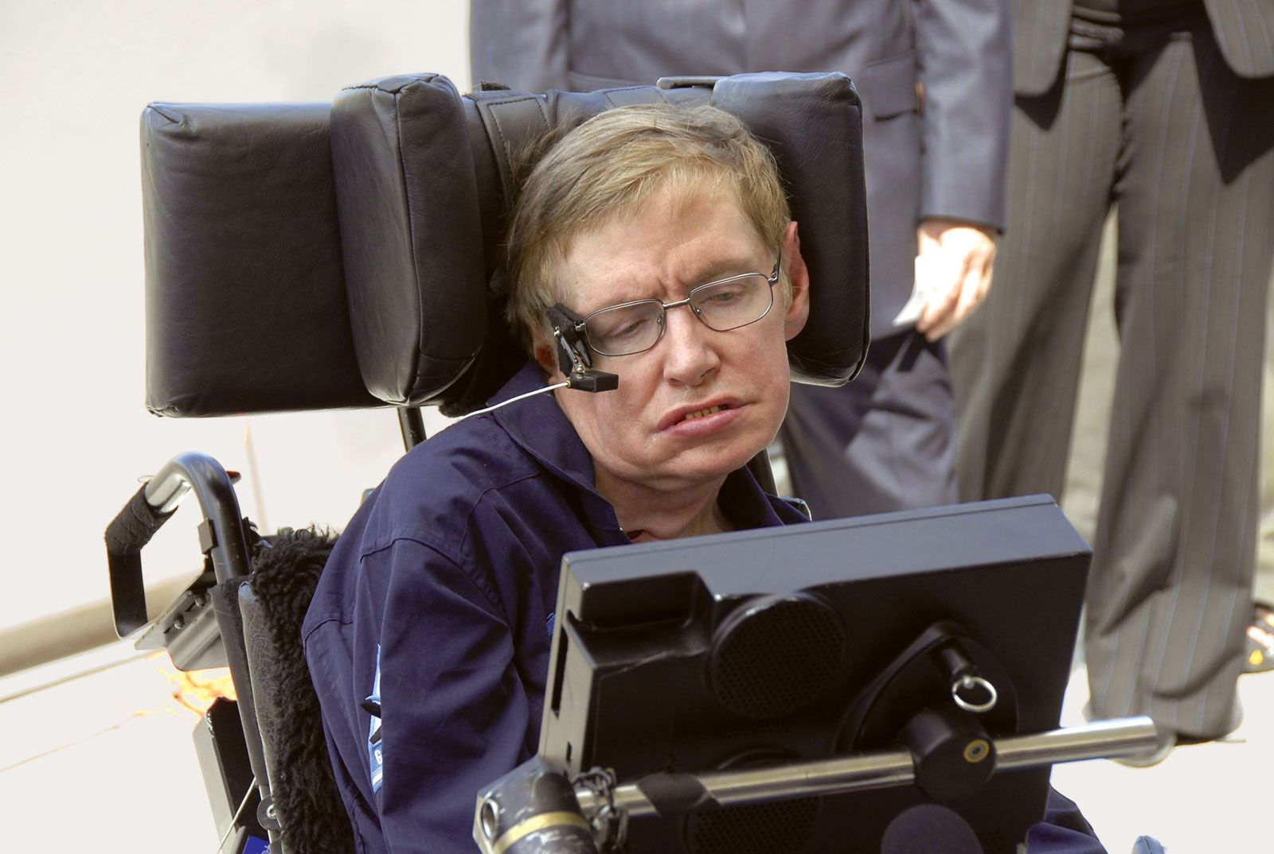
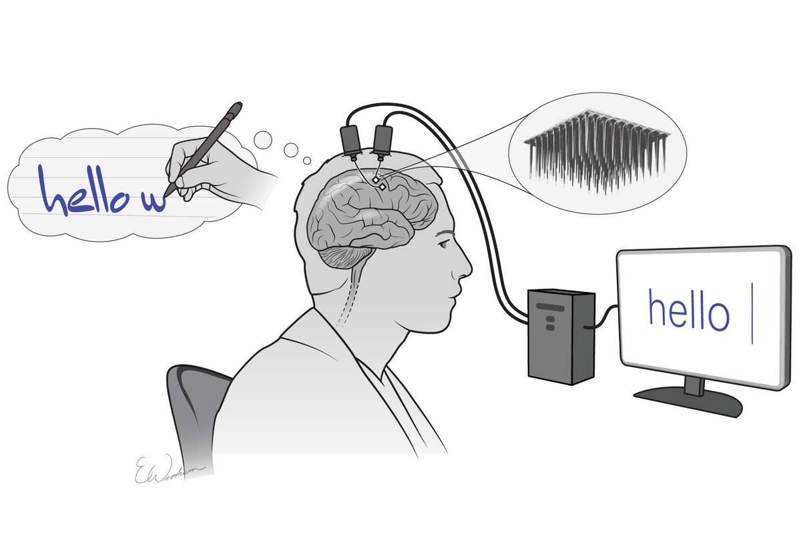
Why does this matter? The promise of brain-computer interfaces (BCI)
Current communication systems for people with disabilities
can be quite slow and frustrating to use.
BCI devices could be better

Slide 4
We are seeking to replicate and improve on the results of a recent scientific study
The original study sought to create the best yes/no binary predictor for nine participants with spinal cord injuries and strokes.
Each participant came for two sessions several days apart
At each session they wore an array of thirty EEG electrodes and were asked to think about five different mental tasks forty times per task, for a total of 200 trials per session.
And most importantly for our purposes – they released the raw data so we can use it to try and replicate and improve on their results
Can we build a model to accurately differentiate between two of those five trial types?

Slide 5
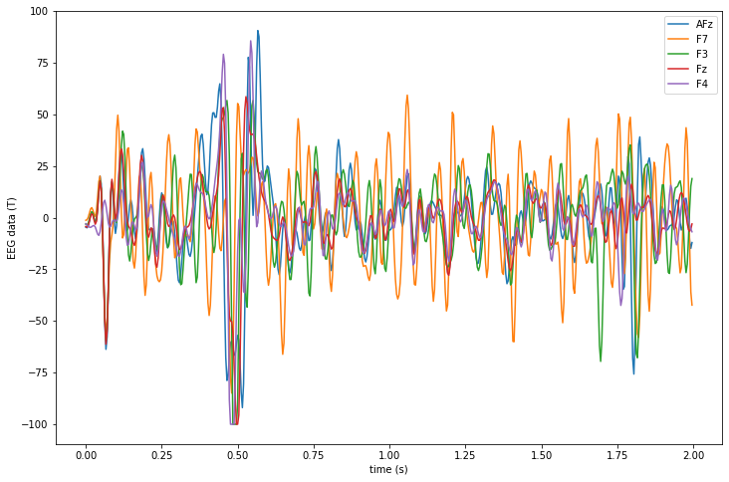
This is what EEG data looks like

Slide 6
I combined several different kinds of models to try and solve the problem
Convolutional Neural Network (big filters)
Convolutional Neural Network (small filters)
LDA + Common Spatial Patterns (CSP)
Neural Network + CSP
Neural Network
Final prediction for each trial

Slide 7
Unfortunately, my model wasn’t able to adapt to the changes from day 1 to day 2
Day 1
Day 2
90%+ cross-validated accuracy for some subjects
55% accuracy

Slide 8
Takeaways
EEG data is highly variable – need more data!
People with central nervous system injuries have messier EEG data
Neural networks don’t magically solve all problems
Techniques are needed to account for skew in the same persons EEG readings – rebias?
AWS is a lifesaver when you need more computing power

